Slide 1
Oh Crap, My Code is Slow
Chris Tankersley
@dragonmantank
Madison PHP Conference, September-October 2016

Slide 2
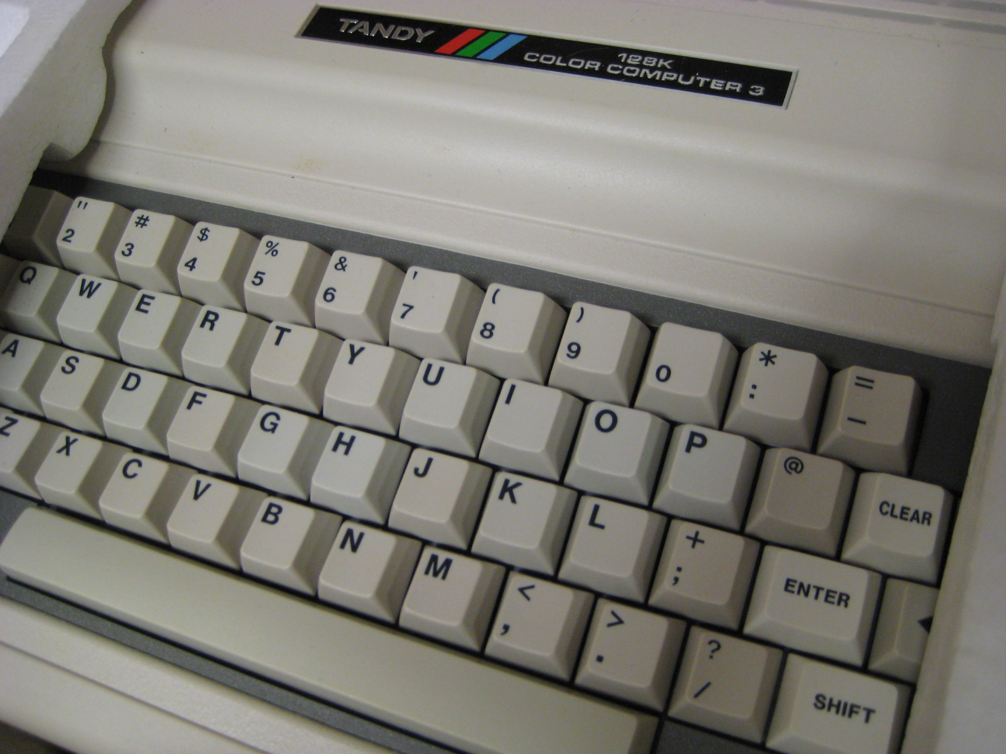
1.79 MHz 8-bit Processor
128K RAM
640x192 max resolution
64 color palette
RS-232 Serial Port
Cartridge Bay
2 Joystick Ports
Disk Extended Color Basic 2.1

Slide 3

520 Mhz Apple S1
512MB RAM
390x312 resolution (~303 ppi density)
16 million colors
WatchOS

Slide 4
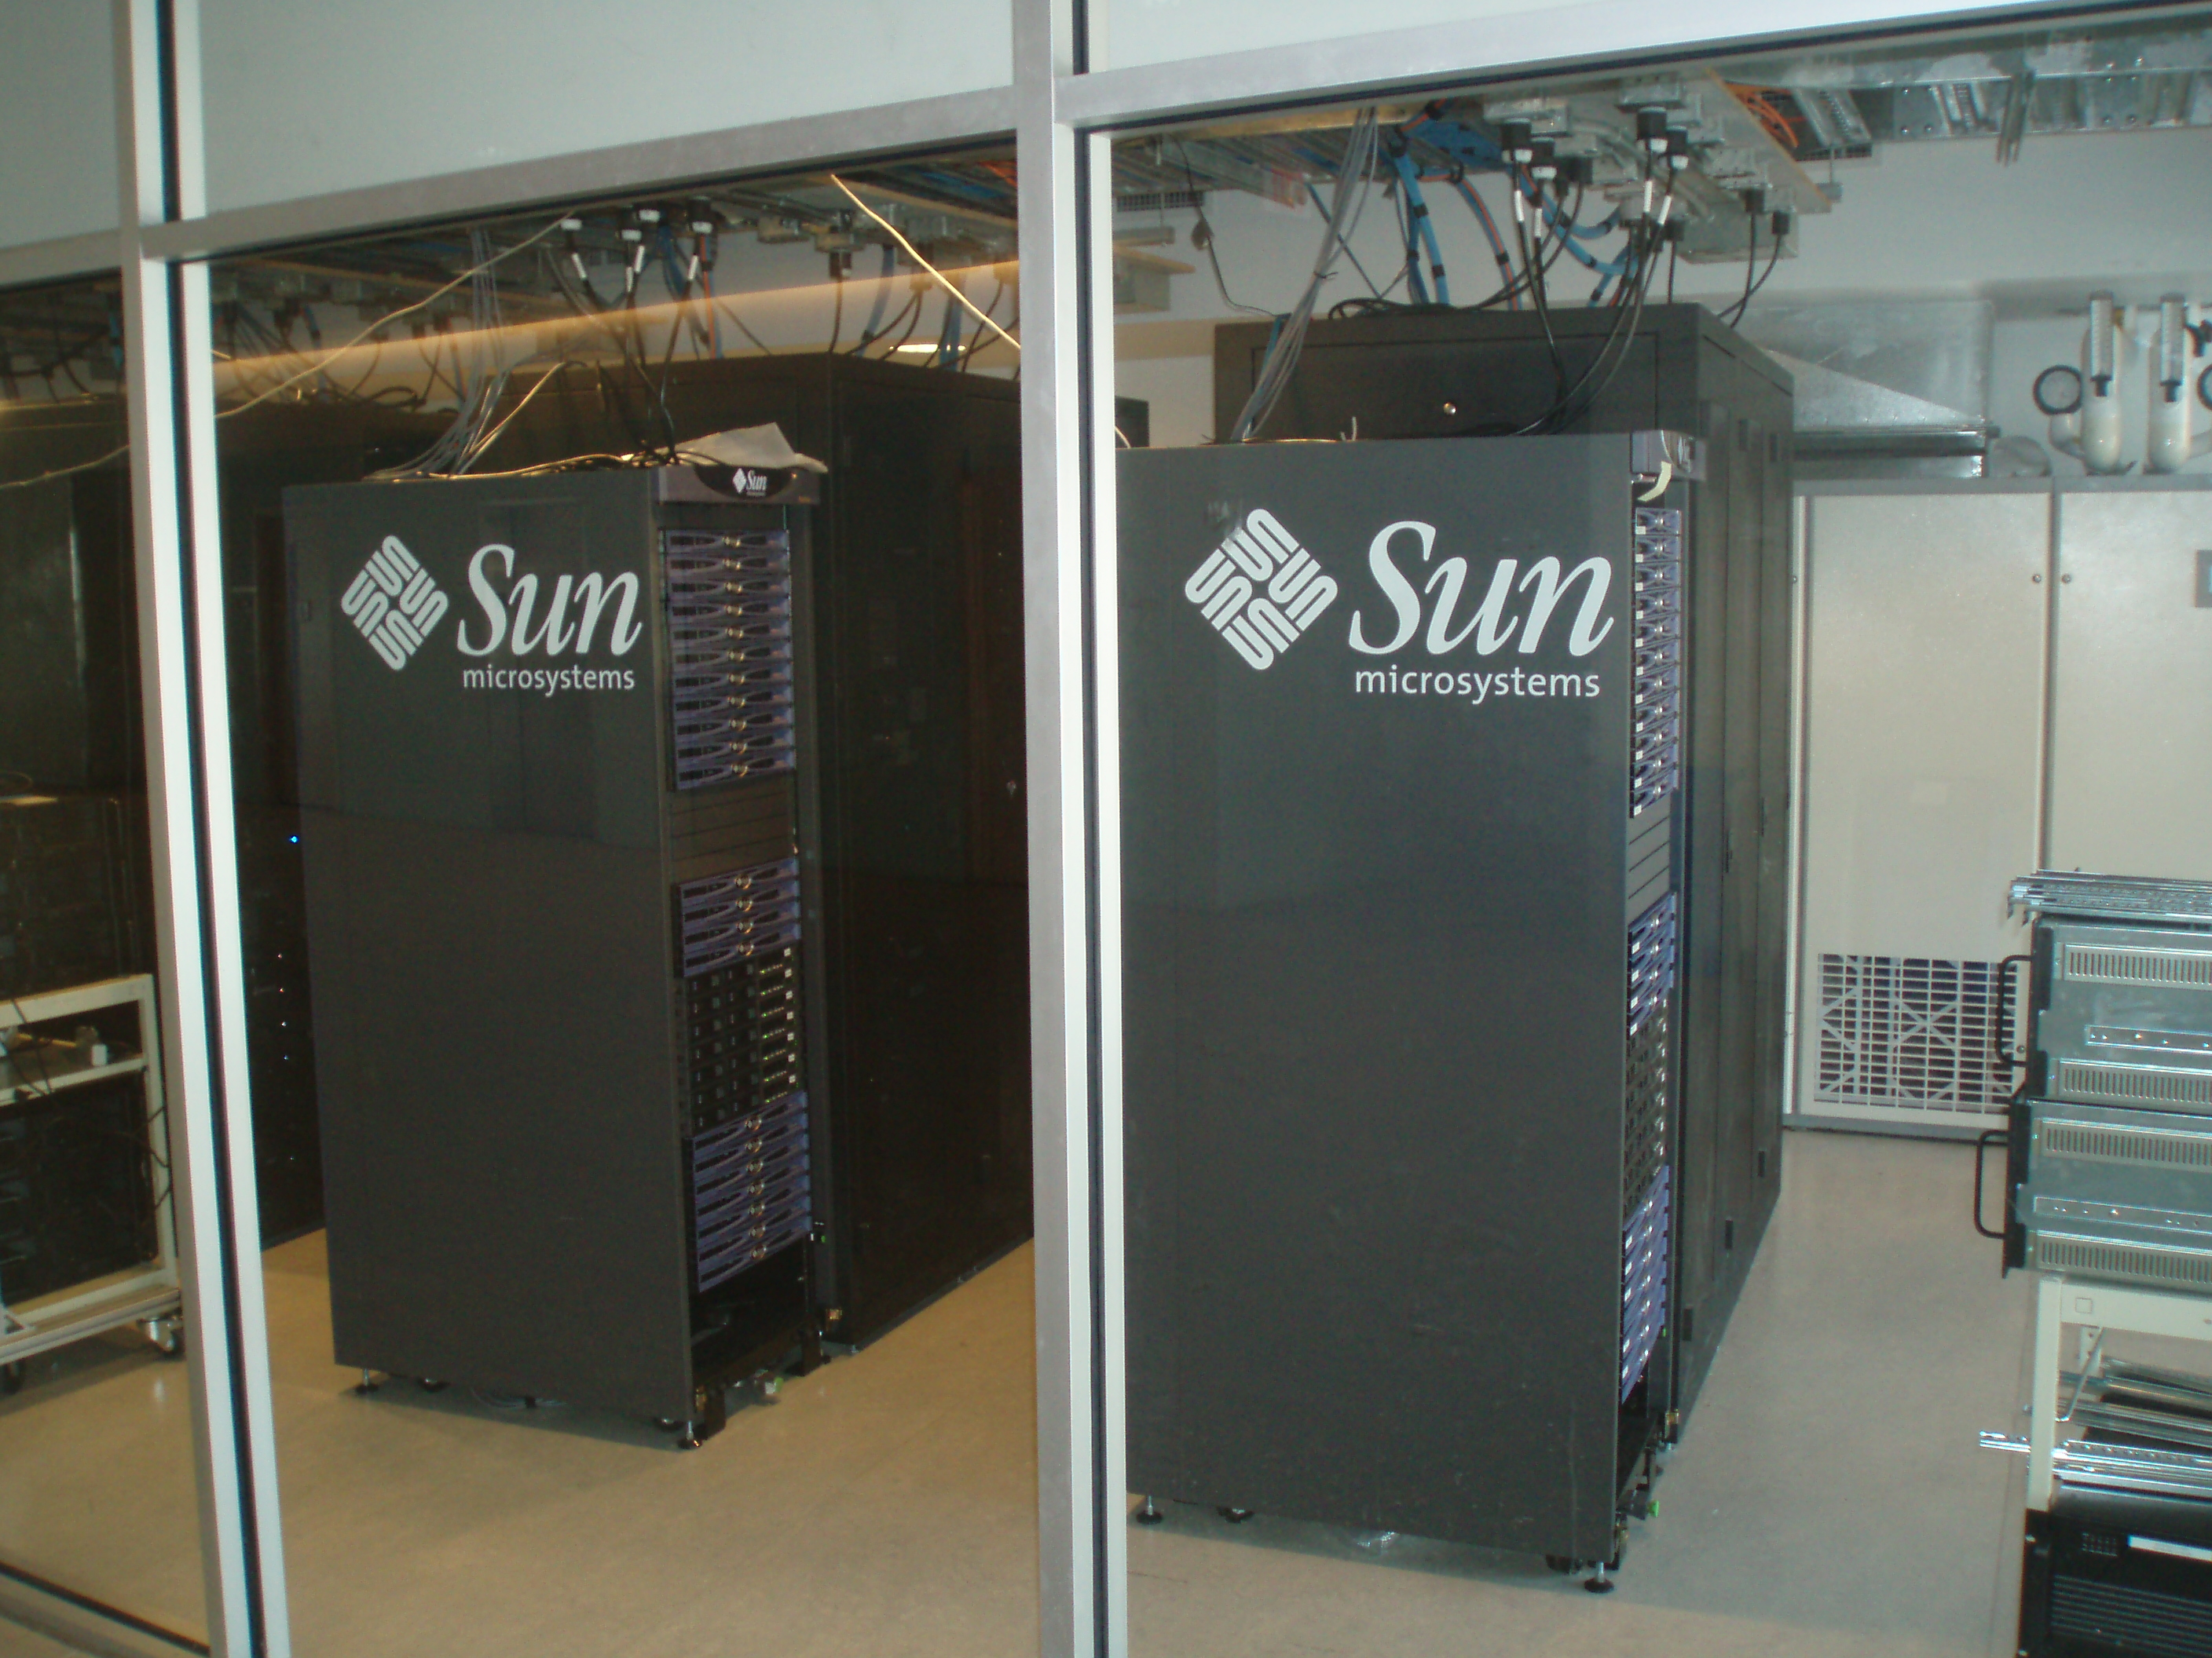
32 Cores
512GB RAM
1-10Gbps NICs
10 Terabyte FusionIO Cards

Slide 5
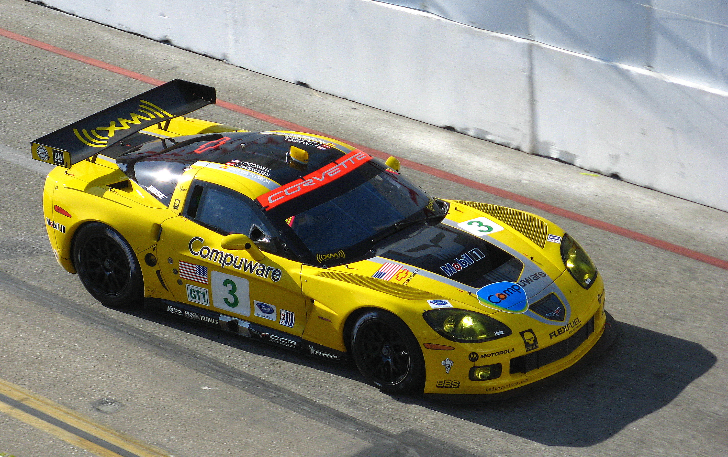

Slide 6
“premature optimization is the root of all evil.”
Donald Knuth, “Structured Programming With Go To Statements”
Notes:
Programmers waste enormous amounts of time thinking about, or worrying about, the speed of noncritical parts of their programs, and these attempts at efficiency actually have a strong negative impact when debugging and maintenance are considered. We should forget about small efficiencies, say about 97% of the time: premature optimization is the root of all evil. Yet we should not pass up our opportunities in that critical 3%.

Slide 7
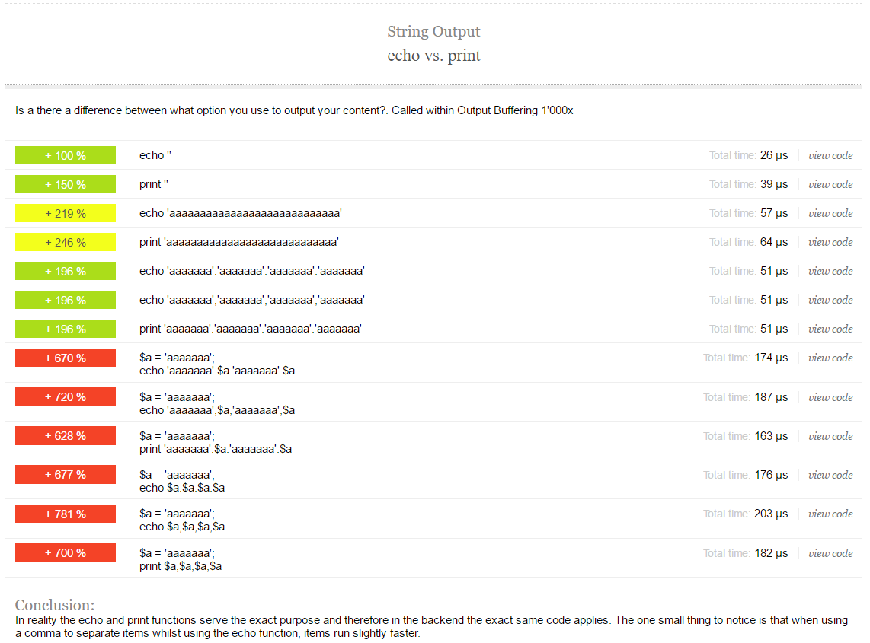
www.phpbench.com

Slide 8
It Doesn’t Matter

Slide 9
We Are the 3%

Slide 10
Who is at fault?
3rd Party Connections
I/O Performance
Database

Slide 11


Slide 12


Slide 13


Slide 14
4 Hours
Cache Ad Campaign Data
Cache Analytics Data
Run Numbers
Sync Products

Slide 15
4 Hours
Cache Ad Campaign Data
Cache Analytics Data
Run Numbers
Sync Products

Slide 16
The Problems

Slide 17
Running Numbers was heavy
Primary server would spike under load
Secondary servers would get out of sync and go into “rollback”

Slide 20
Product Sync was Slow
Just took hours to run

Slide 21


Slide 22
Product Sync

Slide 23
Just Start Logging
Add DEBUG log messages with timestamps
Where is it slow?

Slide 24
Seldaek/monolog
use Monolog\Logger;
use Monolog\Handler\StreamHandler;
// create a log channel
$log = new Logger(‘job_debug');
$log->pushHandler(new StreamHandler('path/to/your.log', Logger::DEBUG));
// add records to the log
$log->debug(date(‘Y-m-d H:i:s’) . ‘ – Contacted API’);
// Do our business logic
$log->debug(date(‘Y-m-d H:i:s’) . ‘ – Finished with page’);

Slide 25

Culprits

Slide 26
What did we find?
All calls to Product API had to be full sets, couldn’t subset
Calls to Product API were slow, but not horrid
Generating and inserting the Products were slow due to business logic
Blocked Operations:
Getting next page from API
Processing products

Slide 27
Our Workflow
// Original Workflow
Get Page X from API
For Each Product:
Extract Data from XML
Transmogrify the Data into a Product Object
Save Object to DB
If No Next Page:
Break
Else:
Page++
Continue

Slide 28
Solution – Out of Band Processing
// Original Workflow
Get Page X from API
For Each Product:
Extract Data from XML
Transmogrify the Data into a Product Object
Save Object to DB
If No Next Page:
Break
Else:
Page++
Continue

Slide 29
Solution – Out of Band Processing
// Job 1 - Cache Product API Calls
Get Page X…X+10 from API
Cache XML to Database
If No Next Page:
Break
Else:
Page++
Continue
Call Job 2
Respawn Job

Slide 30
Solution – Out of Band Processing
// Job 2 – Insert Products
Get Page X…X+10 from DB
For Each Product:
Extract Data from XML
Transmogrify the Data into a Product Object
Save Object to DB
If No Next Page:
Break
Else:
Page++
Continue

Slide 31
Run Totals

Slide 32


Slide 33
Background
Was originally PHP
Turned into a MongoDB Script because it was too slow

Slide 35
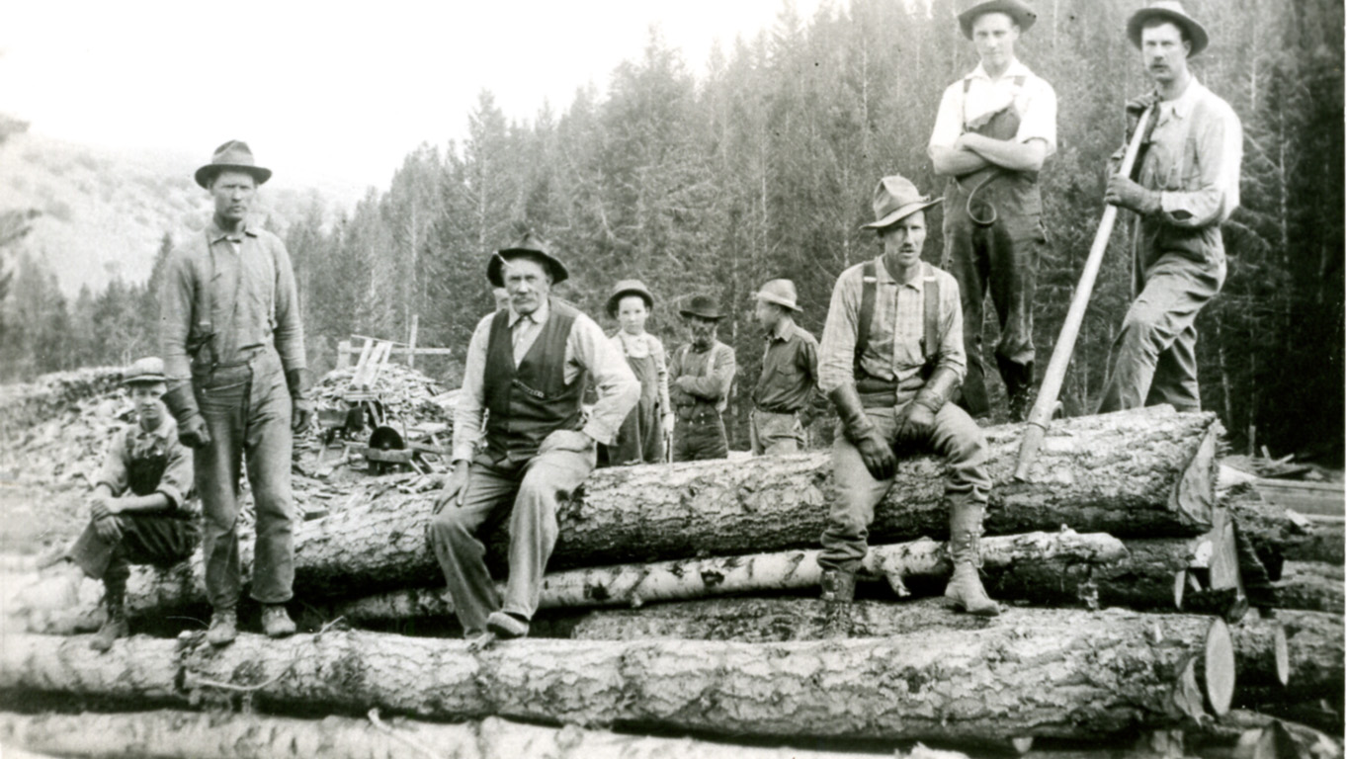

Slide 36
What did we find?

Slide 37
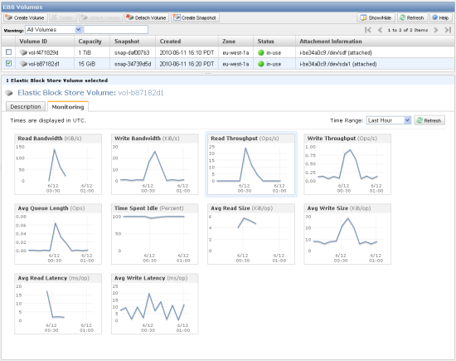
Check the Server Metrics
https://aws.amazon.com/blogs/aws/new-cloudwatch-metrics-for-amazon-ebs-volumes/

Slide 38

Suspect

Slide 39

Our Solution – Throw Hardware At It

Slide 40
Our Solution – Throw Hardware At It
Increased IOPs on the SSD’s
Larger Instances on AWS

Slide 41
Our Solution – Move out of MongoDB
Rewrite the script back into PHP
Run in our worker system

Slide 42

The Result

Slide 43

The New Bug
It took 5 hours to run

Slide 44
Suspect

Slide 45


Slide 46


Slide 47
What did we find?

Slide 48

Code Profiling

Slide 49
xhprof
Low-cost dynamic analysis for PHP
PHP Extension
Store results in a DB
Has a pretty good GUI
https://www.digitalocean.com/community/tutorials/how-to-set-up-xhprof-and-xhgui-for-profiling-php-applications-on-ubuntu-14-04

Slide 50
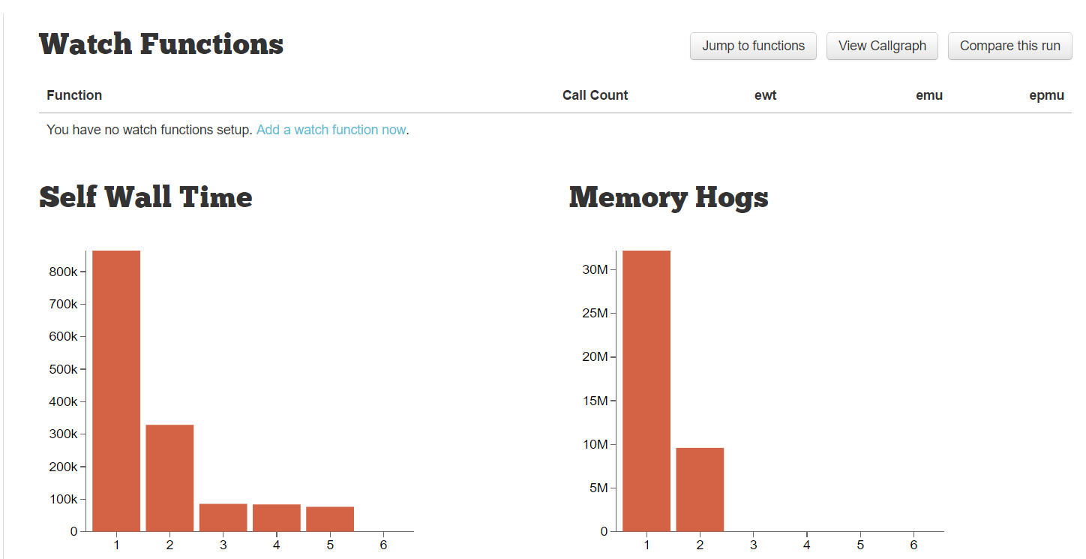
Pretty Graphs

Slide 51
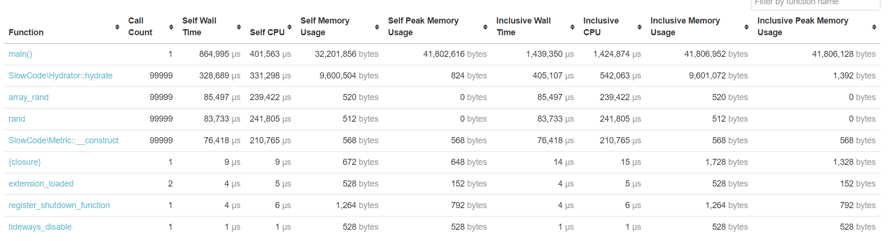
Useful Metrics

Slide 52
What we find?
Hydrating objects was expensive
We were doing deep hydration, resulting in extra DB and hydration calls
We had authentication checking happening in a loop, due to bad logging code

Slide 53
The result?
It brought it down to around 3.5 hours

Slide 54
Valgrind
General programming tool for checking memory debugging, memory leaks, and code profiling
Supported by xdebug
KCacheGrind/QCacheGrind to view output

Slide 55
Enable it in xdebug
zend_extension=/usr/lib/php/20151012/xdebug.so
xdebug.profiler_enable=1
xdebug.profiler_output_dir=/var/www/tests/xdebug

Slide 56
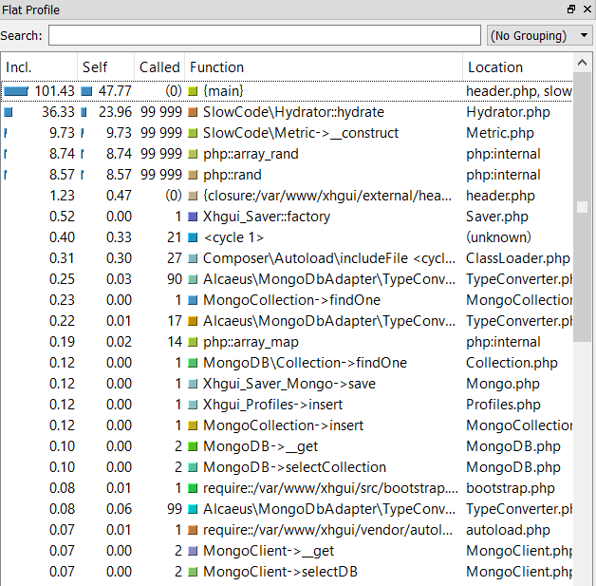
Function Calls and Code Flow

Slide 57
What we find?
We were looping a lot
We were looping big loops inside small loops
We were looping through a lot of the same data multiple times

Slide 58

The Result – Reduce the Looping
Runtime was reduced to 30 minutes

Slide 59
Tips for Slow Code
Use Monolog to add Debugging messages
Use xhprof to profile “live” code
Use xdebug and Valgrind to get deeper profiling

Slide 60
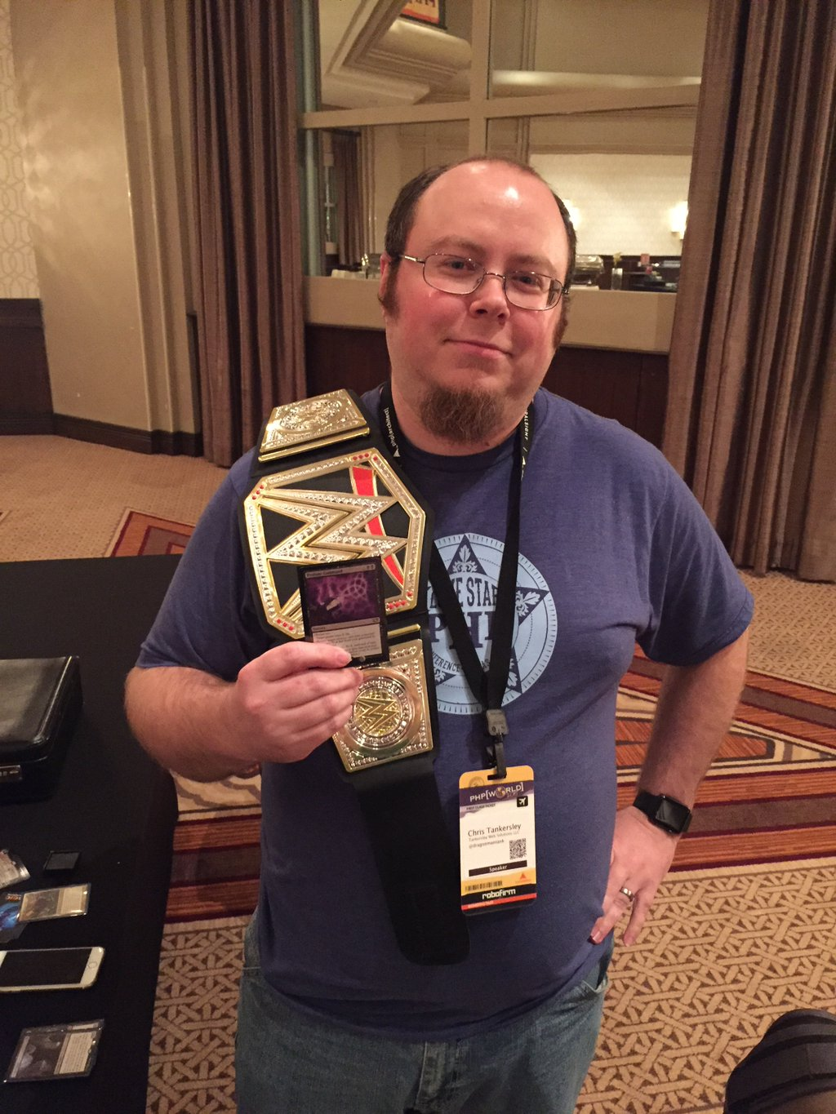
Thank You!
https://github.com/dragonmantank
Author of “Docker for Developers”
https://leanpub.com/dockerfordevs
http://ctankersley.com
chris@ctankersley.com
@dragonmantank

Slide 61
Credits
Slide 13 – Andrei.D40 – Stacks of Books, Flickr
Slide 34 – Upper Snake River Valley Historical Society – 3339 loggin, Flickr

